Slide 1
Secure Data Hiding in Image Using Steganography
CAPSTONE PROJECT
Presented By: Edunet foundation
Student Name : BABARIYA SMIT
College Name & Department : UKA TARSADIA UNIVERSITY & ASHA M TARSADIA

Slide 2
OUTLINE
Problem Statement
Technology used
Wow factor
End users
Result
Conclusion
Git-hub Link
Future scope

Slide 3
Problem Statement
In 4 to 5 lines( write in precise words)
In that project we work on steganography technic because this technic is use for secure (secret) communication between two or more entities and less chance to alter communication. That’s why we create steganographyc model with help to coding.

Slide 4
Technology used
Mention libraries, platforms,
In that project we use python language(3.11 version) to create a model and use opencv package and also use getpass package. This project in I am use VS code platform.

Slide 5
Wow factors
What makes this project stand out from other project(Unique features)
In this project i am use getpass package for typing password confidential. It is not showing password whenever we type password at run the code.

Slide 6
End users
Who are the end users
Steganography is the practice of hiding information within other data. It is use to Cybersecurity Professionals, Intelligence Agencies and Military, Journalists, Artists and Creatives, Healthcare Professionals etc.

Slide 7
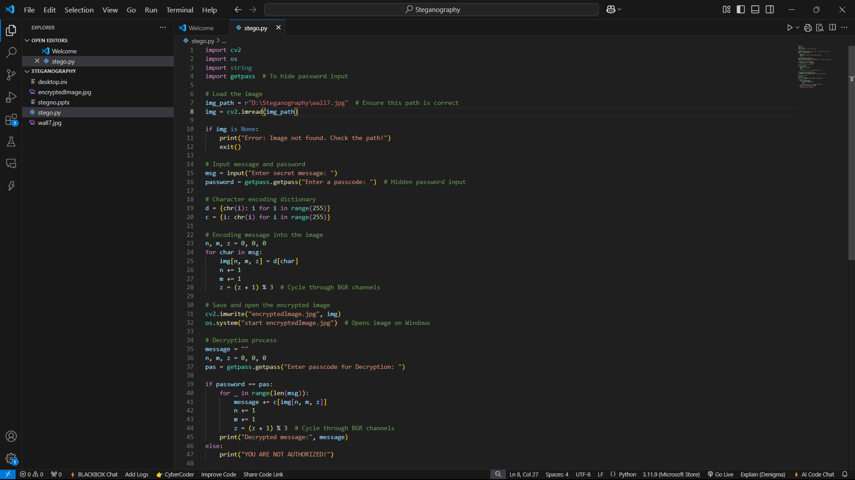
Results
Screenshots of the outcome (min 3):-code screenshot

Slide 8

Results
Screenshots of the outcome (min 3):-output screenshot

Slide 9
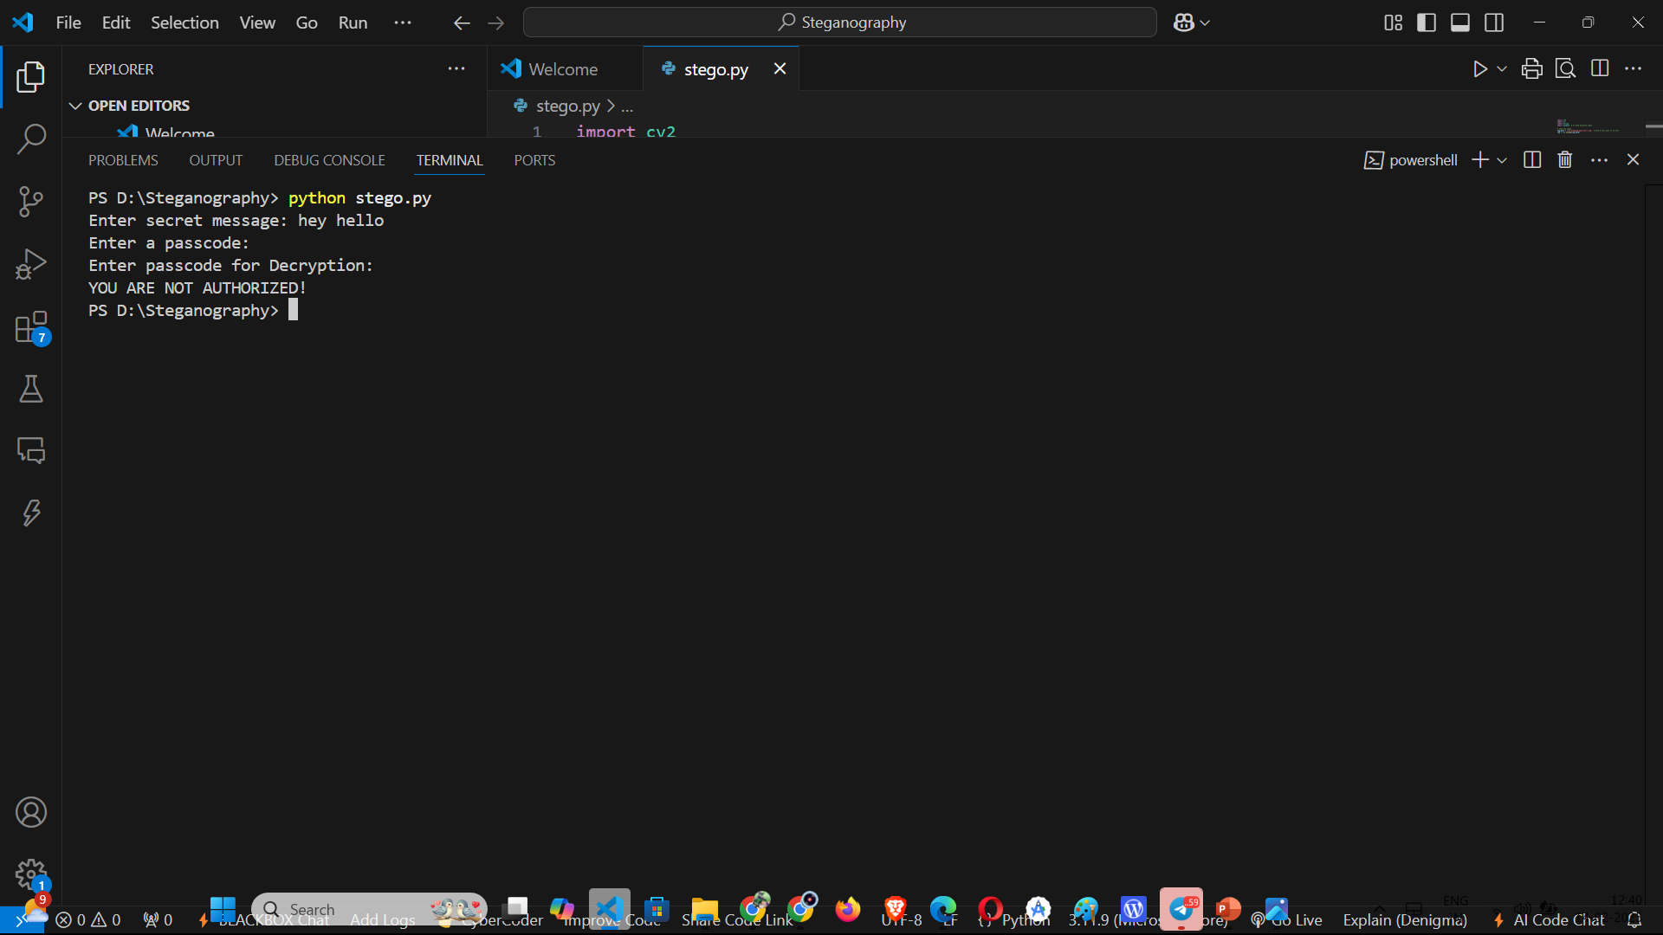
Results
Screenshots of the outcome (min 3):wrong password -output screenshot

Slide 10
Conclusion
Conclude your project concerning your problem statement
This project give us to best understanding for steganography technic and give unique way of secret communication.

Slide 11
GitHub Link
Make sure that there should be readme file
https://github.com/BABARIYA-SMIT/Steganography.git

Slide 12
Future scope(optional)

Slide 13
THANK YOU

